Slide 1
Michigan Learning Connection Summit
Better with Breakfast

Slide 2
Welcome
Kyle Guerrant
Deputy Superintendent
Finance and Operations
Michigan Department of Education
Notes:
Welcome and introduce yourself thank the committee for their work and Michigan Dairy Farm Families for supporting the Summit
Housekeeping items
Agenda is in your notebook-
Restrooms are to my left down the concourse
Please stay to the end as we will be holding a drawing for a $100.00 Amazon gift card and a $50.00 Amazon gift card, you must be present to win
Please turn in your evaluation at the end of the day at Gate G as you exit

Slide 3
Food Insecurity and Learning
Nancy Lindman, MA, Director of Public Policy, Michigan Association of United Ways
Kait Skwir, MS, RD, Deputy Director, Food Bank Council of Michigan
Alicia Guevara Warren, MP AFF, Kids Count Project Director, Michigan League for Public Policy
Notes:
Introduce Bryan
Bryan Van Dorn - Manager, Healthy Kids, United Way for Southeastern Michigan. Since 2010, Bryan has been working in multiple capacities, in both the public and nonprofit sectors, to connect child nutrition programs to those that benefit from them, those that administer them, and the myriad of partners that provide support and advocate for them. Along the way, he has been able to build and support collaborative groups centered on more effective distribution and utilization of child nutrition programs in a variety of communities across Michigan, as well as participate in strategic initiatives at the local, state, and national levels.

Slide 4
Meet ALICE

Slide 5
ALICE
Asset Limited
Income Constrained
Employed
Funded by Consumers Energy and local United Ways
Funded by Consumers Energy and local United Ways
Notes:
The ALICE project is anchored by the ALICE report

Slide 6
What does the ALICE Report describe?
Household Survival Budget
ALICE Threshold
ALICE Income Assessment
Economic Viability Index
Notes:
The Household Survival Budget calculates the actual costs of basic necessities (housing, child care, food, health care, and transportation) in Michigan, adjusted for different counties and household types.
The Household Survival Budget is used to define the average level of income, or the ALICE Threshold, a household needs to afford the basics.
The ALICE Income Assessment is calculation of all sources of income, resources, and assistance for ALICE and poverty-level households. The Assessment reveals a significant shortfall from what is needed for households to attain the ALICE Threshold.
The Economic Viability Index evaluates the economic and community conditions in each county which make it easy or difficult for a household to support themselves financially. Housing, Jobs available, Community supports

Slide 7
ALICE Survival Budget
Notes:
The Bare Minimum Household Survival Budget Increased By 18 percent from 2007 to 2015
Housing – HUD Fair Market Rent for an efficiency single two-bedroom apt for family
Child care – registered home-based care, home-based care has only voluntary licensing, so quality may vary
Food – USDA Thrifty Food Plan,
Transportation – average annual expenditures by car and public trans from Bureau of Labor Statistics Consumer Expenditure Survey.
Health Care – nominal out-of-pocket health care spending, medical services, prescription drugs, and medical supplies using Consumer Expenditure Survey. Penalty 325 single, 975 family
MSCLS 10%, cover cost overruns
Taxes: fed and state income taxes where applicable

Slide 8
How many households are struggling
40%
60%
Poverty & ALICE
15% 25%
Above ALICE Threshold

Slide 9
Notes:
ALICE lives in every county – From 59% in Lake to 27% in Livingston. Only 3 counties below 30% - Eaton, Emmet and Livingston 27
ALICE is in Rural and Urban counties

Slide 10
How Much Does ALICE Earn?
Notes:
Nothing defines ALICE as much as work!
ALICE households are working hard at jobs that are important in our communities. We need ALICE – ALICE is taking care of our children and our older adults. ALICE is the economic engine on our community, but is struggling to make ends meet.
But the Challenge for ALCIE is that 62% of Michigan’s job’s pay less than $20 per hour, and 60% of those jobs pay less than $15 an hour. I know that we haven’t been served breakfast yet, but let’s do the math: We know from the survival budget that it takes $28 dollars an hour to cover the very basics for a family of four.
Making it nearly impossible for

Slide 11
Basic Needs with Public and Nonprofit Spending
Notes:
We know that ALICE is struggling to meet all of the very basics – the blue bar shows how much is needed in each of the areas to cover the basics and it shows the gap in funding available by each survival budget category even when public benefits and nonprofit supports are added to ALICE households income (the gold bar – solid shows earned income, hash mark gold adds work support benefits – like SNAP and free and reduced lunch). We see the largest gaps in transportation and Child Care budget categories and important the EITC tax assistance is for ALICE households.
The bottom line is – a very large proportion of Michigan households struggle to make ends meet, earned income plus benefits doesn’t cover basic needs. The problem is systemic, and we need to work together to improve conditions and the odds for kids to reach their potential.

Slide 12
For the ALICE Report visit
www.michiganALICE.org
Notes:
We’ve been talking about state-level ALICE data. The report provides ALICE data on the state, county and township/city level.

Slide 13

The Self-Sufficiency Standard for Michigan 2017
Michigan Learning Connection Summit
5/2/18

Slide 14
Food Bank Council of Michigan
The Food Bank Council of Michigan's mission is to create a food secure state through advocacy, resource management, and collaboration among stakeholders and Michigan's unified food bank network
169 million pounds distributed, 64 million of which were fresh produce
Nearly 3,000 pantries
Food insecurity- 15.1% for general population, 18% for children
Addressing child food insecurity through: Backpack, summer feeding, after-school/Kids Café, Head Start, Cooking Matters, school pantries
Notes:
Background on FBCM
Started in 1984 through collective efforts of regional food banks.
Food insecurity: USDA measure of lack of access to, at times, enough food for an active, healthy life for all household members and limited or uncertain availability of nutritionally adequate foods.
Hunger can have adverse effects on a child’s ability to learn, Alicia will touch on that later

Slide 15
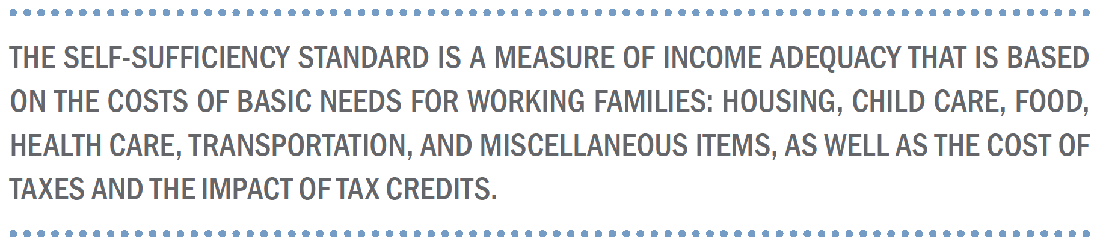
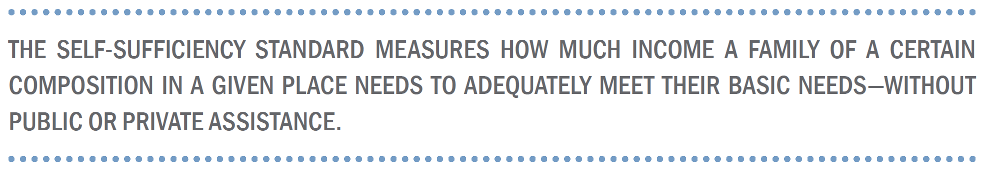
What is the Self-Sufficiency Standard?
Notes:
Michigan joins 38 other states in having commissioned this research from the Center for Women’s welfare at the University of Washington. Only one commissioned by a food bank network. This research is similar to MAUW’s ALICE study, but analyzes a larger group of household types- this is less a survival budget, but more a built out budget to move beyond survival.
So let’s start with an overview of the Standard and what it means for Michigan. The Standard is a measure of what it takes realistically to meet basic needs at a minimally adequate level, without any help from family, friends, or public/private assistance.
This study helps us to answer the question who needs help and how much help do they really need?

Slide 16
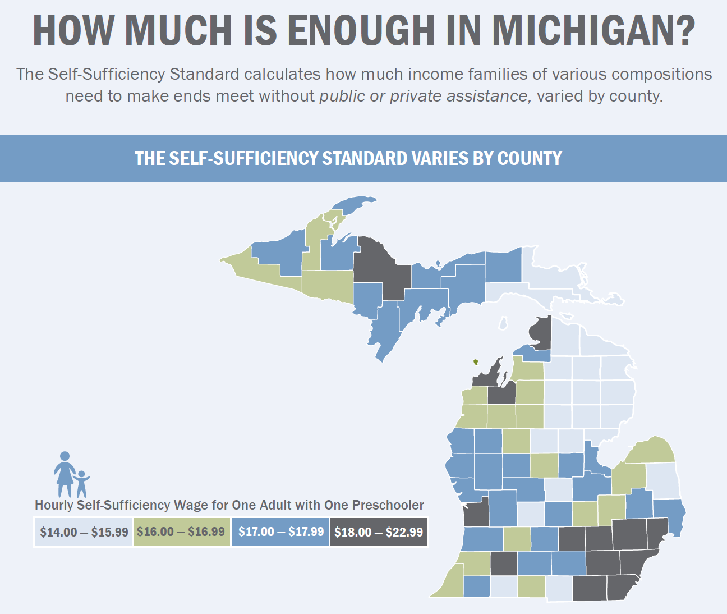
Notes:
As you can see, there is a lot of variance across the state, in terms of wages needed to be self-sufficient. Wayne County needs $18-22.99 for one adult and one preschooler

Slide 17
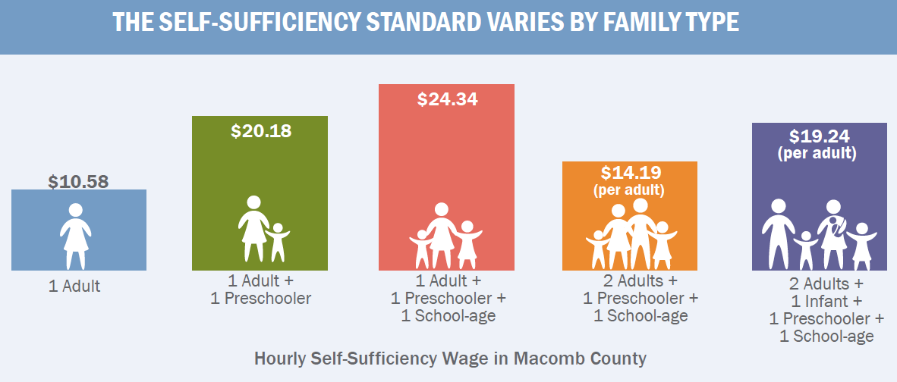
Notes:
You’ll find that the self-sufficient wage also varies a lot by family type
Lots of variation between family types- the study shows a basic needs budget for over 700 different variations of family composition

Slide 18
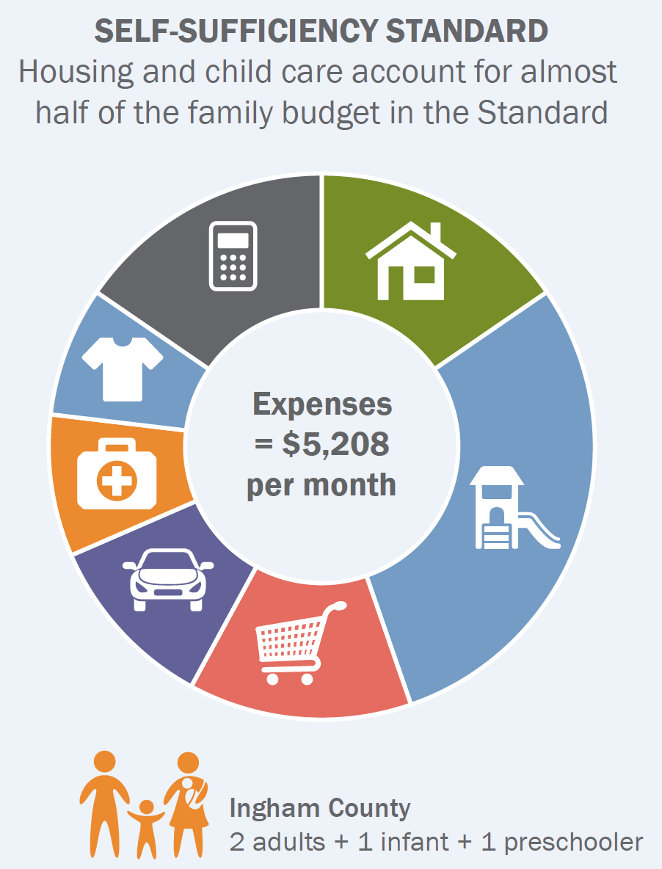
Notes:
For a family with two adults, one infant and one preschooler in Ingham Co, child care is 30% of the family’s budget while housing is 16%
Michigan is different from other states in that relatively childcare takes up a larger portion of a family’s budget than other costs; nationally both housing and childcare are the biggest expenses, but in Michigan childcare takes up a larger portion. You’ll see in the study a difference in income needs as a child becomes older and requires less childcare than an infant or preschooler.

Slide 19
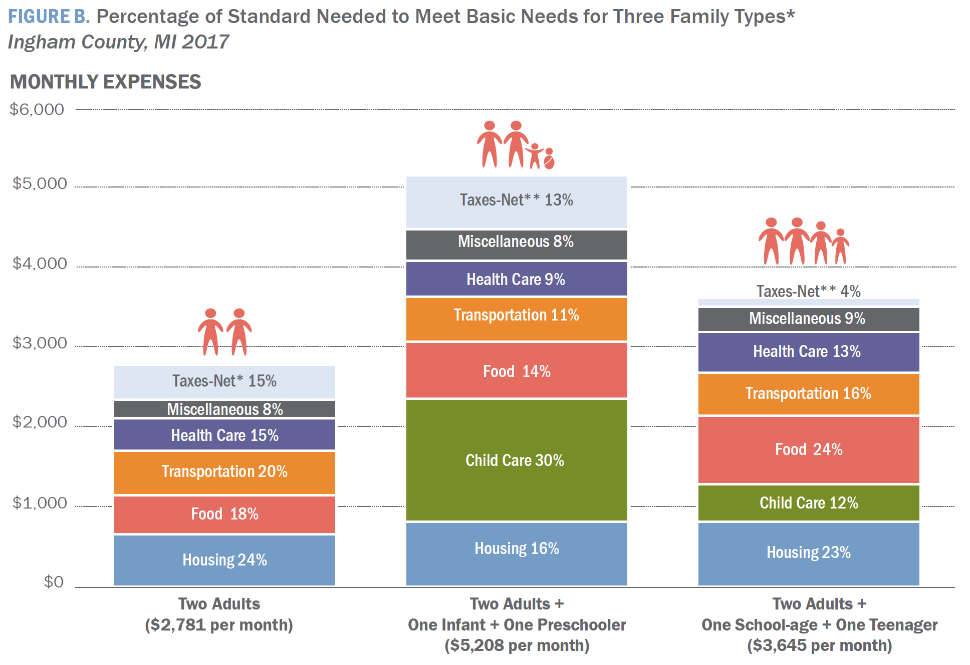
Notes:
As a family changes composition, the amount spent in certain areas change. Each bar here shows the percentage of the total budget needed for each expense and how it differs as the family changes composition.
As a family grows, monthly expenses increase, and childcare is added (and takes up the largest portion of the budget). New parents are often at the beginnings of their career and earning their lowest lifetime wages, and are at a disadvantage.

Slide 20
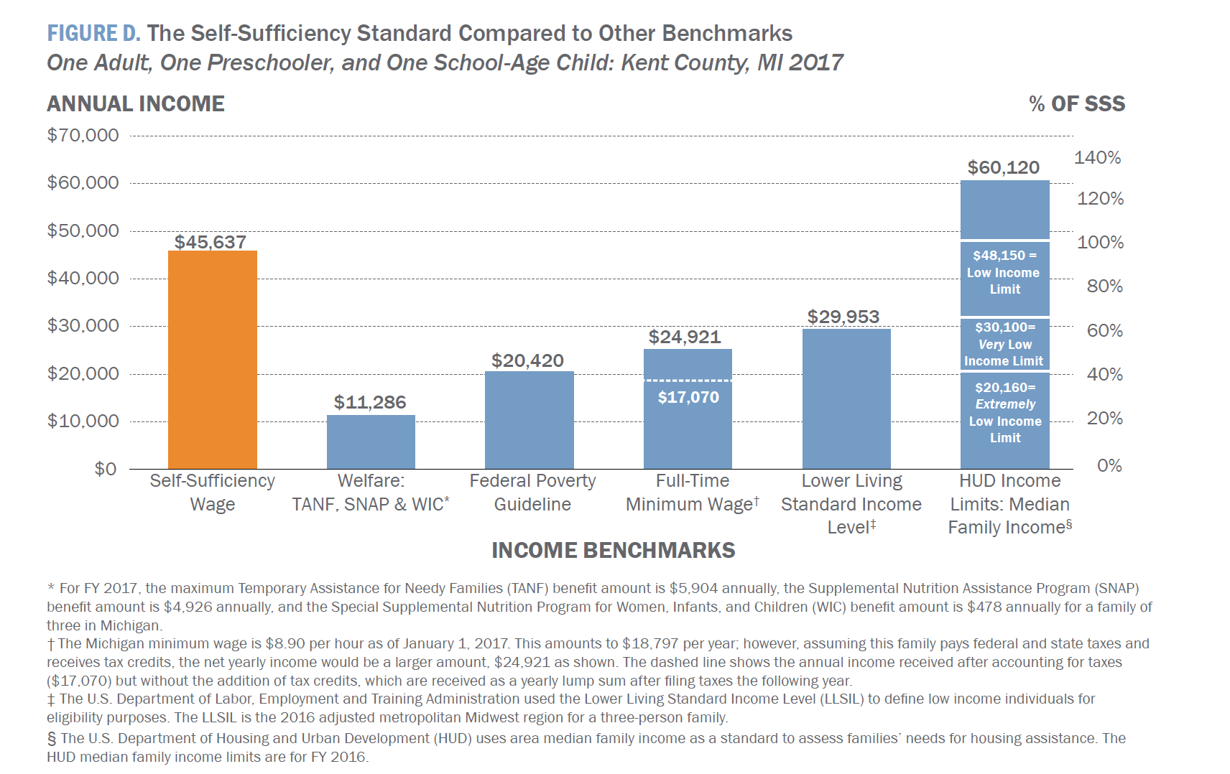
Notes:
Compare the standard to other benchmarks of income- for example for someone on welfare, they only get about ¼ of what they need. Federal poverty level is about 40% . We know the federal poverty measure is out of date, but this shows just how far off it is.
The Standard is a more realistic measure, and you’ll see that is is double and triple some of the other accepted measurements

Slide 21
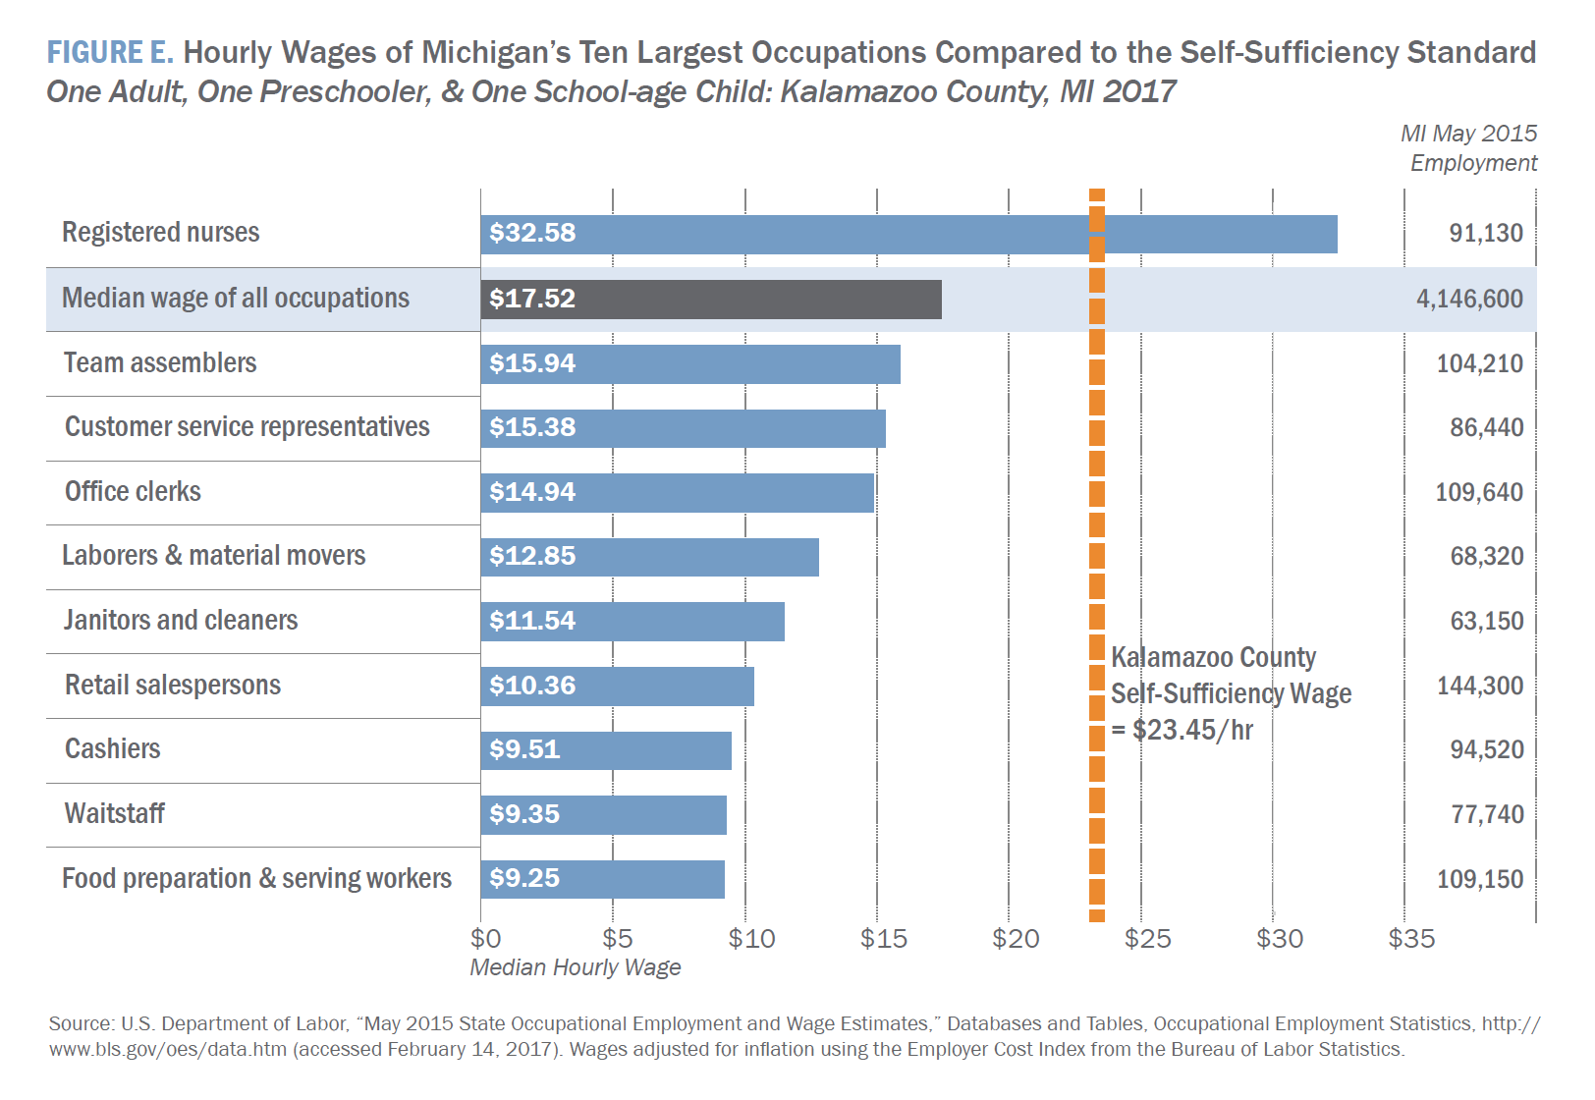
Notes:
Getting to self-sufficiency is very challenging in today’s labor market. Michigan is not the most expensive place to live, but this is a relative measure compared to the occupations that are available; for example only one of the top ten occupations in Michigan pays a self-sufficient wage, to complete a bare-bones budget (no lattes, no pizza, no vacations). Kalamazoo County is in the middle in terns of cost of living.

Slide 22
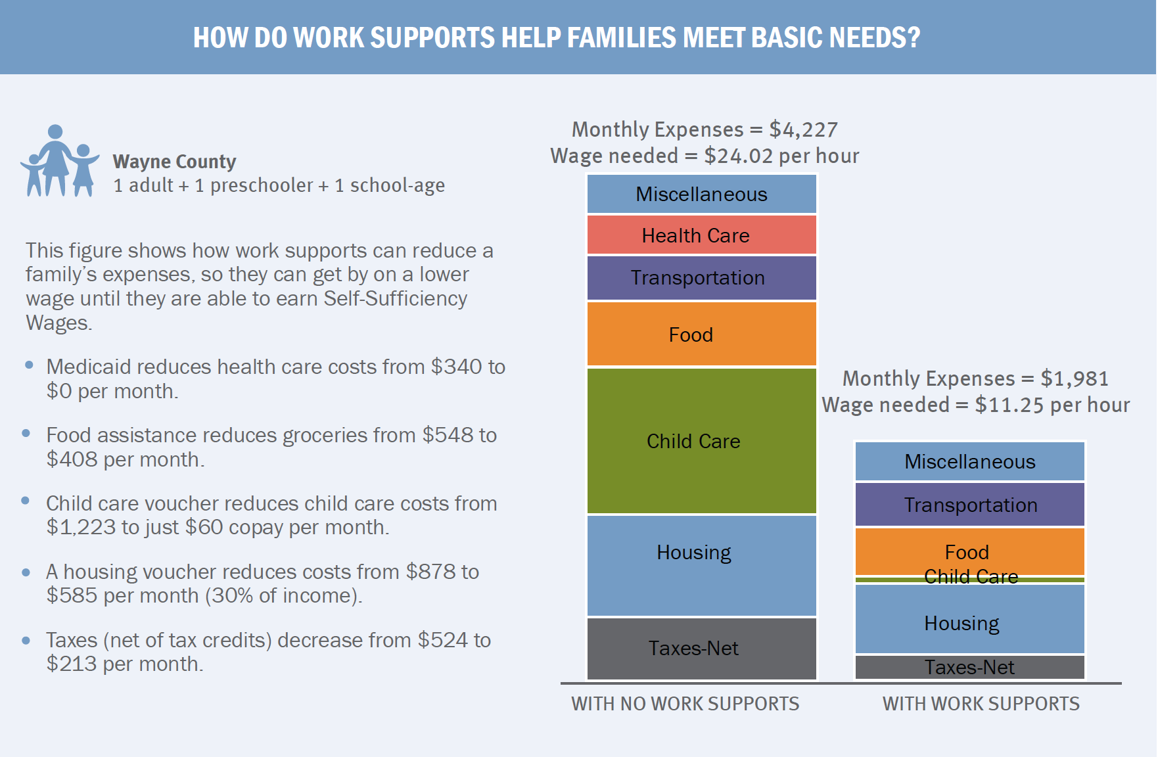
Notes:
What is really important are programs that provides work supports, or programs that provide assistance like food pantries, or child care assistance, to allow families to get to the jobs that work for them, and work towards stability.
We know that many of the clients seeking help in the food bank network are employed, so this study gives up credibility in something we know and are seeing every day.
The standard provides not just the bottom line amount, but a budget breakdown. You can see not only a minimum, but how much it adds up to, so it helps people understand that it oftens is not a budgeting issue or making poor choices, it is that families need a bottom line of resources either from wages or work supports.
It takes a certain amount of money to meet basic needs and families are struggling to do so, especially families with young children;

Slide 23
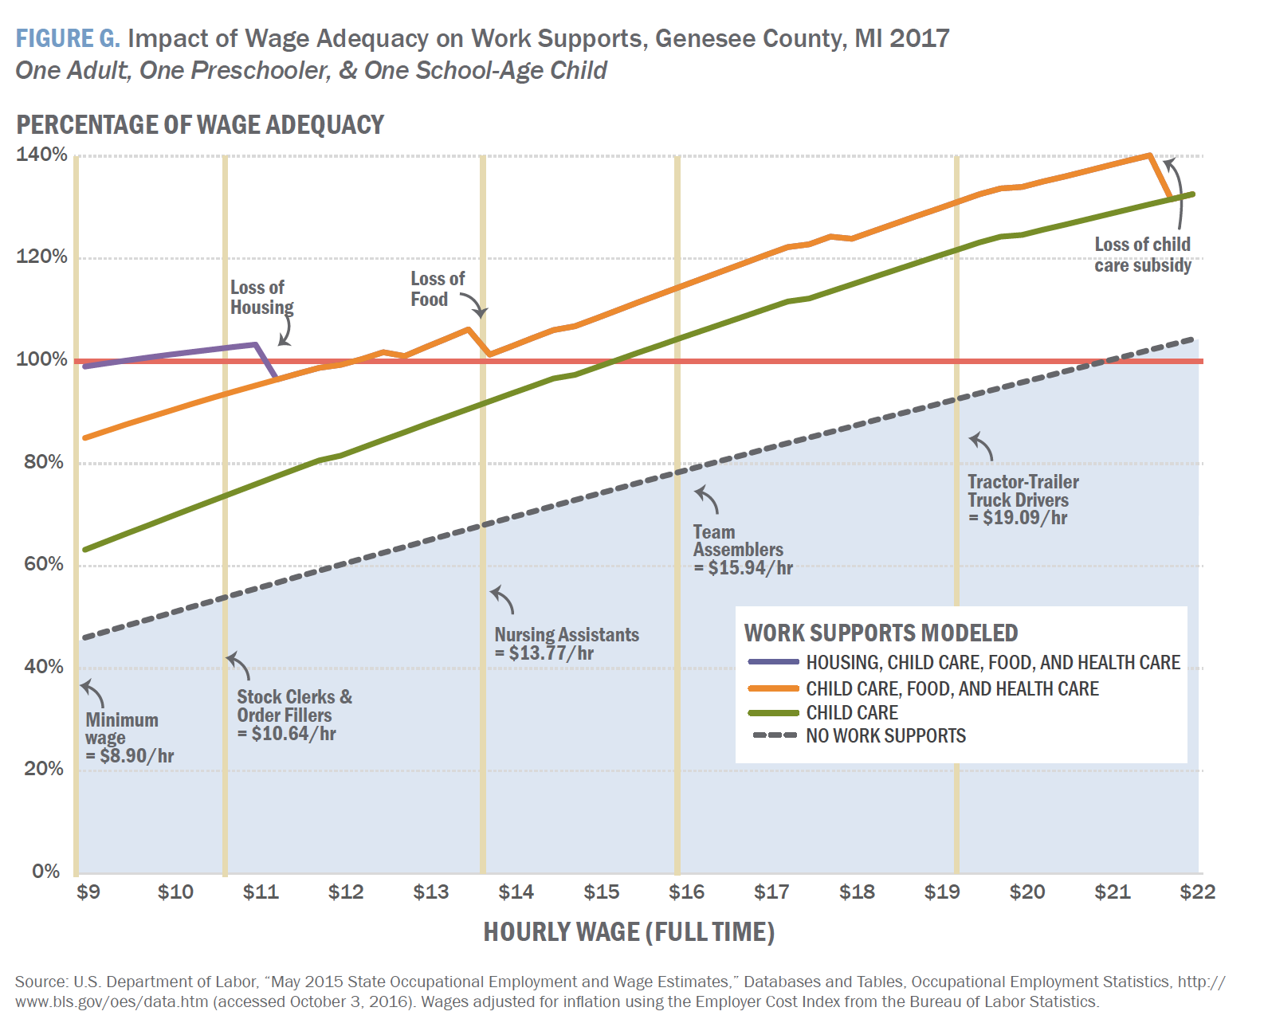
Notes:
Work supports drop off eventually, so there is a limit to the assistance that they provide.

Slide 24
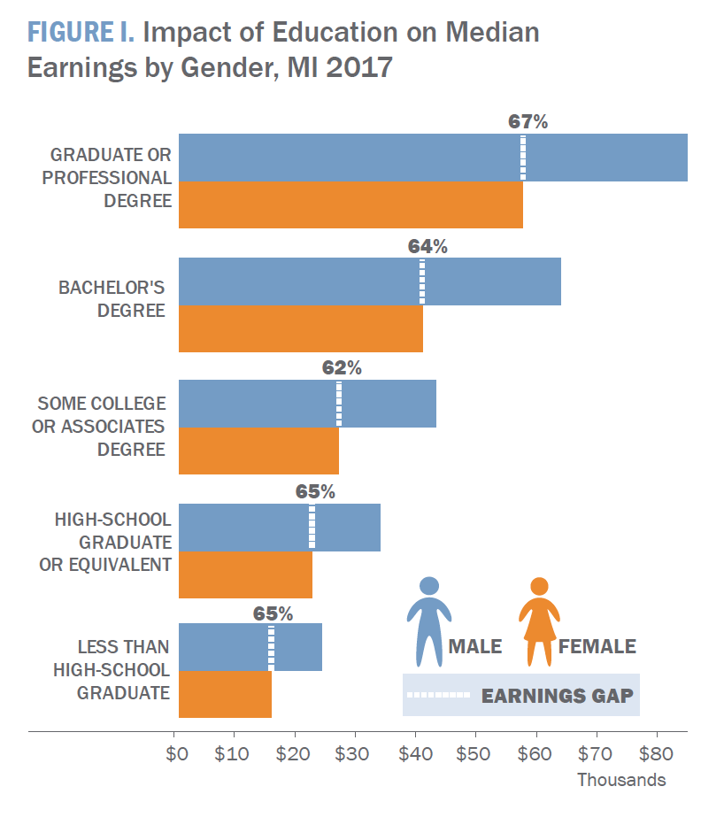
Notes:
Another way to get to self-sufficiency is to raise wages and to address the race and gender discrimination we see in the labor market. You can see here in the gender wage ratio women have to have another level of education to get the same wage as men at the education level below.

Slide 25
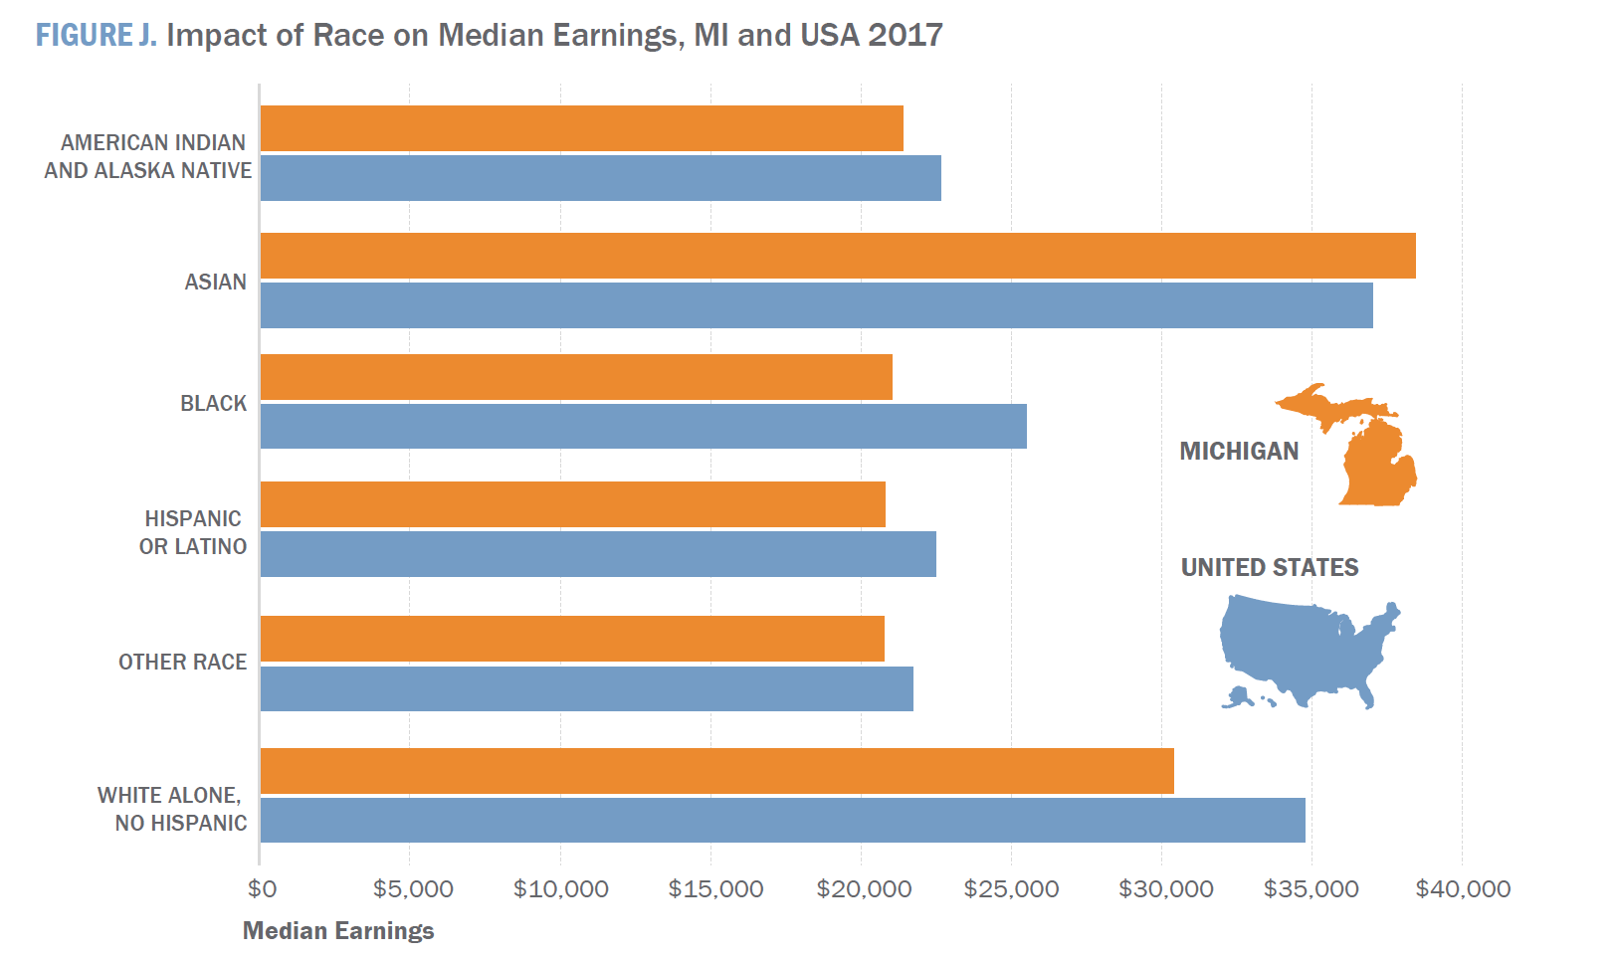
Notes:
A similar thing happens with race wage differential and addressing race discrimination can help people get to self-sufficiency
Other ways to get to self-sufficiency: look at basic education, on the job training, targeted jobs in sector training (look at jobs that actual pay a living wage, and then remove other barriers like transportation or ESL to get people into those jobs)
Counseling workers and clients for career choosing, raising minimum wages to a living wage, unions working toward benefits like paid sick leave

Slide 26
Visit
https://www.fbcmich.org/selfsufficiencystandard
to view the study, data and an interactive table!
Thank you!

Slide 27




2018 Kids Count in Michigan
Michigan Learning Connection Summit
Alicia Guevara Warren
Kids Count Project Director
aliciagw@mlpp.org
May 2, 2018

Slide 28
To advance economic security, racial equity, health and well-being for all people in every part of Michigan through policy change.
The League’s Mission
1223 Turner St. Suite G-1, Lansing, MI 48906-4369  (517) 487-5436
Fax: (517) 371-4546  Web site: www.mlpp.org
A United Way Agency
Notes:
-Poll #1

Slide 29
Kids Count in Michigan
Goals:
Measure child well-being at the state and local levels
Use that information to shape public policies and programs
Improve the lives of children and their families
Tools:
County-level profiles
Data Center
State and national reports
Frames:
Race, place and income matter
Two-generation approaches

Slide 30
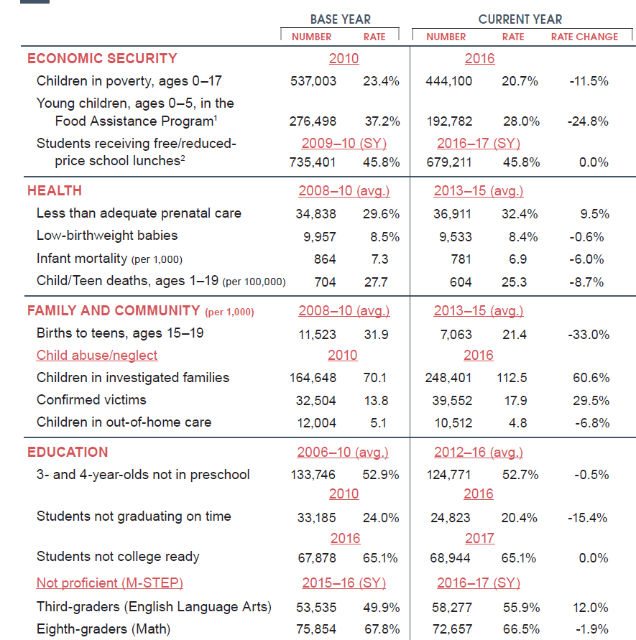
2018 MICHIGAN
DATA BOOK
CHILD
WELL-BEING TRENDS
2010-2016
Notes:
-There are some things getting better…and worse
-But as you can see 5 of 16 trend indicator rates have changed by less than 2%--several of them are completely unchanged since 2010
-And

Slide 31
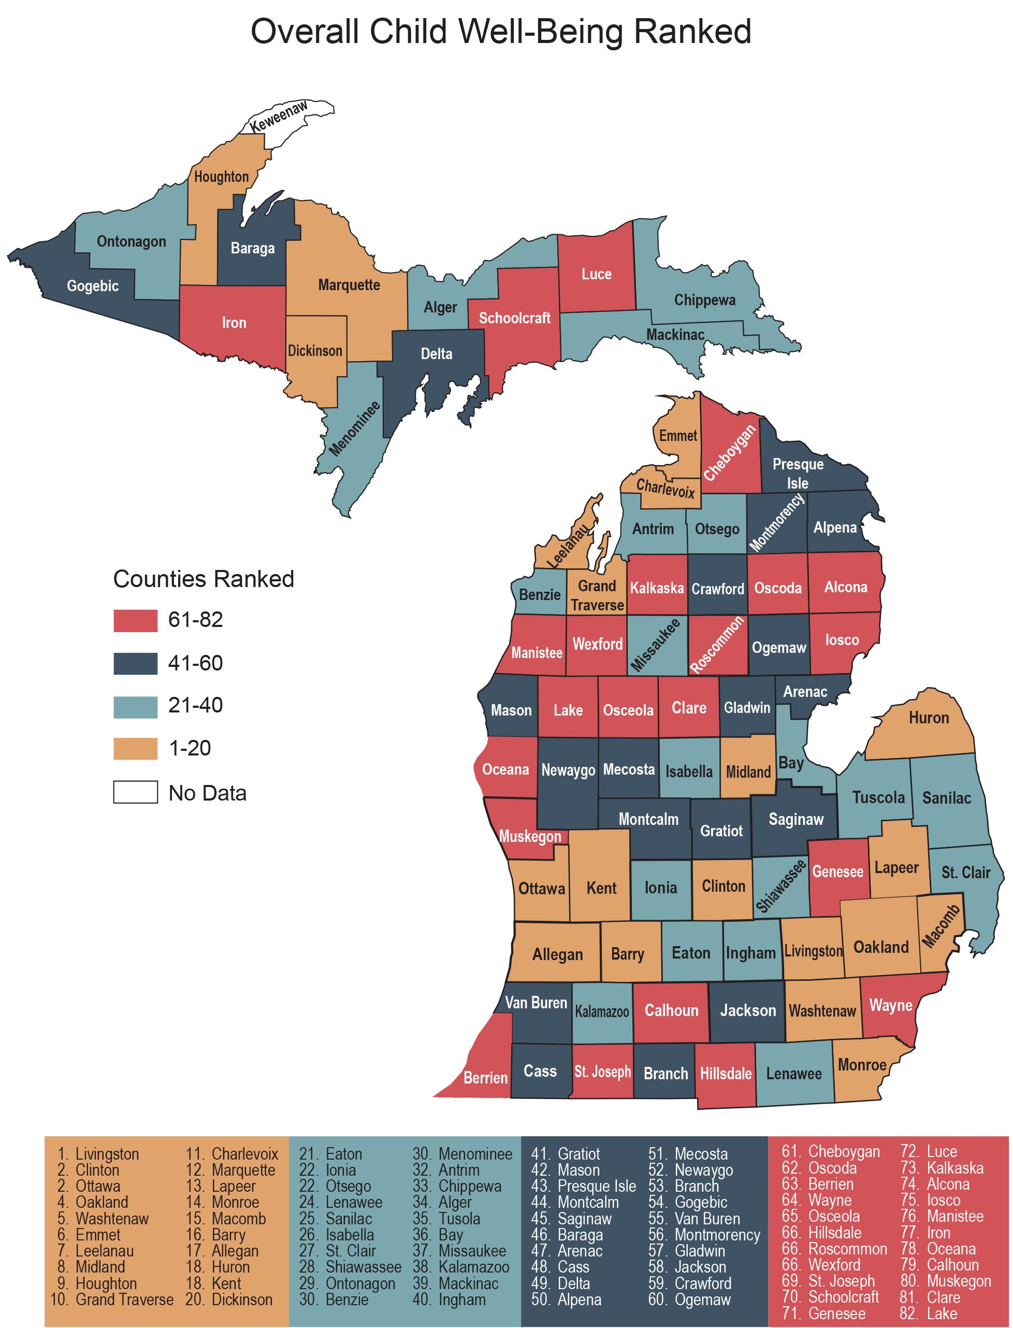
OVERALL CHILD
WELL-BEING
RANKED
Notes:
-Reminder: Do not compare these rankings to previous years rankings

Slide 32

ECONOMIC SECURITY

Slide 33
Key Findings: Economic Security
CHILD POVERTY

Slide 34
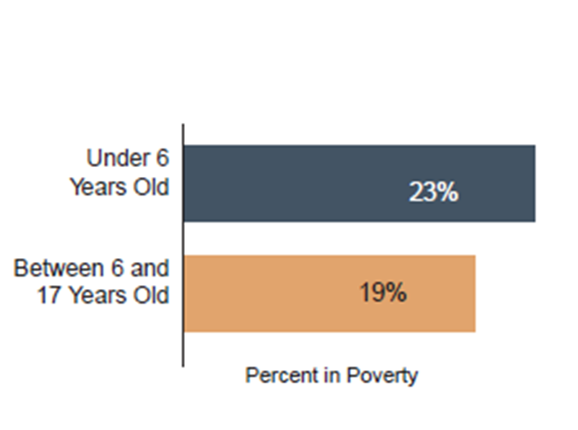
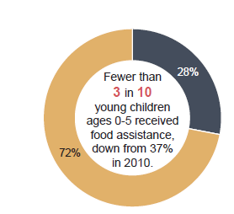
Key Findings: Economic Security
CHILD POVERTY

Slide 35
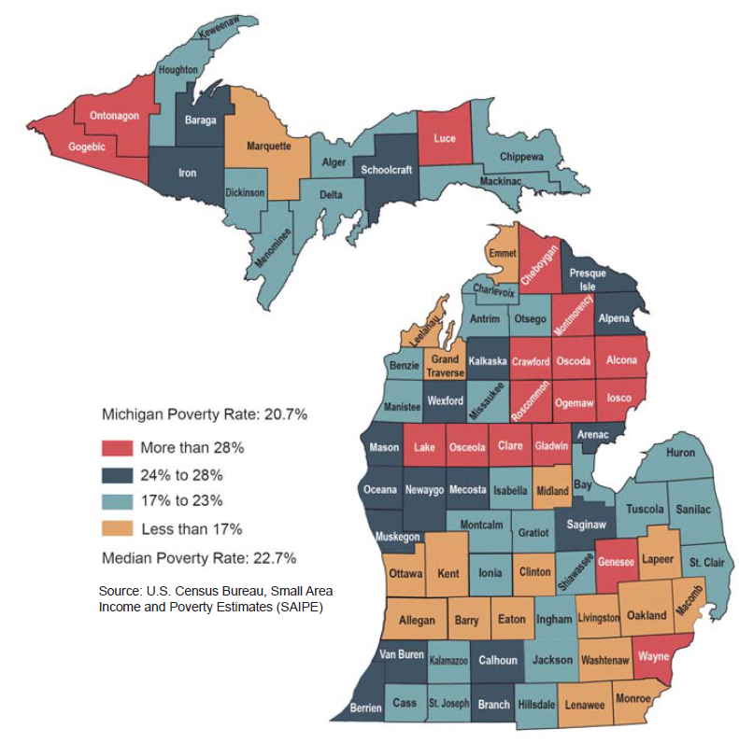
Child Poverty Rate Improved in 73 Counties
Notes:
-Looking at various levels of poverty is also important;
-42% of children live in families with low incomes (200% FPL) ($4,056/month for a family of four)

Slide 36

EDUCATION

Slide 37
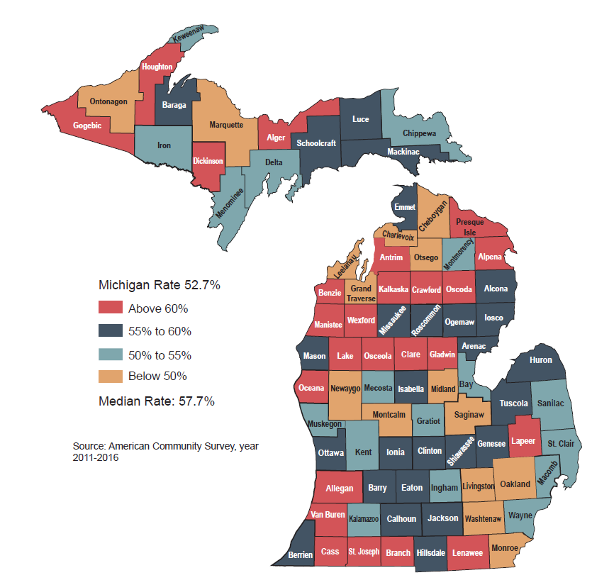
3- and 4-year-olds NOT in Preschool has Remained Steady
MI Rate:
52.7%
Notes:
-Still half of the state’s counties have a rate that is higher than the state average

Slide 38
Key Findings: Education
CHRONIC ABSENTEEISM
Notes:
-Some of the larger rates of chronic absenteeism are with our youngest learners (about 20% in Kinder and 17% in 1st grade, which drops off before rising again in high school where the rates in 10th-12th grade are about the same as the rates for kindergarten and 1st grade)
-About 1 in 4 students from families with low incomes are chronically absent from school compared to about 1 in 13 students from non-economically disadvantaged families

Slide 39
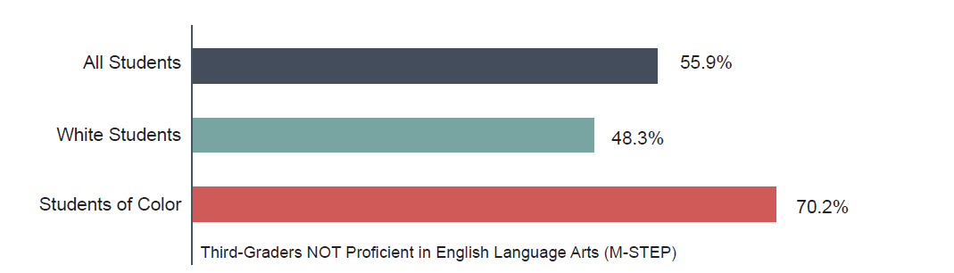
Key Findings: Education
EARLY CARE & EDUCATION
7 in 10 third-graders from economically disadvantaged families are not proficient in reading
Notes:
-Kids of color are more likely to attend underresourced schools compared to their White peers, resulting in disparate outcomes in third-grade reading
-40% of non-economically disadvantaged third-graders are not proficient in reading

Slide 40
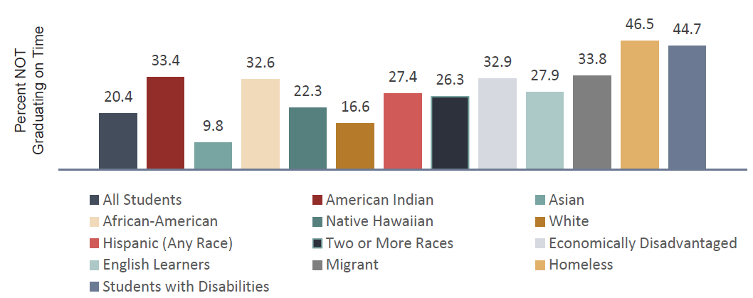
Key Findings: Education
ON-TIME GRADUATION
Notes:
-Students experiencing homelessness and students with disabilities struggle the most to graduate on time

Slide 41
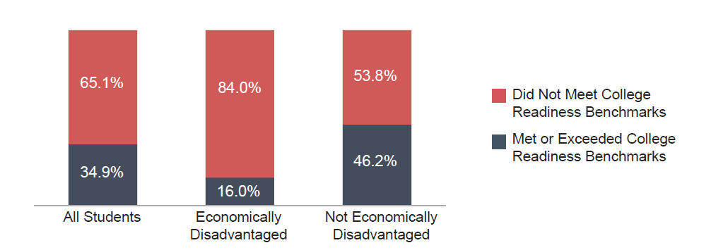
Key Findings: Education
COLLEGE READINESS
Notes:
-Students from families with low incomes are more likely to attend schools with fewer resources to help prepare students for postsecondary training and education

Slide 42
Need additional data?
County profiles from the
data book:
www.mlpp.org
KIDS COUNT Data Center includes Michigan, county, city and township, and Congressional districts:
www.datacenter.kidscount.org

Slide 43
Questions?
aliciagw@mlpp.org
Website: www.mlpp.org
Sign up for “Email Alerts”
Become a member

